Slide 1
The triple layer Business Model
Dr. Alex Osterwalder
PhD in Management Information Systems
Author, speaker and adviser on the topic of business model innovation
Dr. Raymond L. Paquin
DBA from Boston University School of Management
Professor of Management and Sustainability
Dr. Yves Pigneur
www.Flixabout.com
PhD in Information Systems
Professor of Management Information Systems
Notes:
Alexander Joyce, Raymond Paquin and Yves Pigneur Triple-layer Business Model was introduced at the 1st ARTEM Organizational Creativity International Conference on 26-27 March 2015 in Nancy, France.
Titel: The Triple-Layered Business Model Canvas a symbiotic integration of economic, environmental, and social elements.
The Triple Layered Business Model aims to support organisations that wish to innovate upon their current business models and create more sustainable business models. A sustainable business model adds an environmental and social layer to the economic layer, all three of which influence each other crosswise. Far from being a mere obligation, the social and environmental dimensions offer fertile ground for innovation and the discovery of new possibilities.
Alexander Joyce, Raymond Paquin and Yves Pigneur Triple-layer Business Model was introduced at the 1st ARTEM Organizational Creativity International Conference on 26-27 March 2015 in Nancy, France. The three scholars' paper, "The Triple Layered Business Model Canvas: A Tool to Design More Sustainable Business Models," discusses simultaneously improving a business model for economic, environmental, and social benefits. They are all experts in the fields of design thinking, business model innovation, and sustainability. Here are some brief summaries of their credentials:
Alexandre Joyce is a designer, strategist, and facilitator who holds a PhD from Concordia University where he developed the practice of design thinking applied to innovative business models. He has been offering services of design sprint in Quebec since 2016 and has worked with clients such as Hydro-Québec, CAA, and Desjardins.
Raymond Paquin is a professor of management at Concordia University since 2008 and a former editor-in-chief of the journal Systèmes d’Information & Management. He has a DBA from Boston University School of Management and has been a visiting professor at several universities around the world. His research focuses on how firms create collaborative environmental, social, and economic value through interfirm networks, industrial symbiosis, and business model innovation.
Yves Pigneur is an honorary professor at the University of Lausanne and a former editor-in-chief of the academic journal Communications of the Association for Information Systems. He has a PhD from the University of Namur and has been a visiting professor at National University of Singapore and HEC Montréal. He is the co-inventor of the Business Model Canvas and other visual tools used by millions of entrepreneurs and innovators. He is also one of the world’s 50 most influential management thinkers ranked by Thinkers50 and holds its Strategy Award.
Section:
Download the model (PowerPoint) from our website: https://flixabout.com/
Our Youtube channel https://www.youtube.com/c/flixaboutcom
Our homepage www.flixabout.com
The single layer Economic Business model Canvas
Business Canvas Model developed by Alex Osterwalder and Yves Pigneur (youtube.com)

Slide 2
Left canvas
efficiency
Right canvas
value
The triple layer
Published 2015
Sustainable Model
Economics
Environmental
Social
Key partners
Key activities
Value proposition
Customer relationships
Customer segments
Production
End-of-life
Supplies and outsourcing
Functional value
Use Phase
Governance
Societal culture
End User
Key resources
Social value
Channels
Local communi-ties
Materials
Distribution
Employees
Scale of outreach
Cost structure
Revenue streams
Environmental Impacts
Environmental benefits
Social Impacts
Social benefits
Notes:
The three scholars' paper, "The Triple Layered Business Model Canvas: A Tool to Design More Sustainable Business Models," discusses simultaneously improving a business model for economic, environmental, and social benefits.

Slide 3
Of course I approve. Thanks for taking the time to share. So very nice of you.
Here are some suggestions that you can choose not to follow :) It's up to you.
1) The most cited article to share the triple layered business model canvas work is here.
2) The representation that you created adds boxes within the economic canvas. The message conveyed is that the environment and social aspects are within the economic business model. My suggested representation would be 3 layers of canvases. Where there is an environmental, and social dimension of it's own.
Keep up the good work.
Cheers from Montréal,
Alexandre Joyce

Slide 4
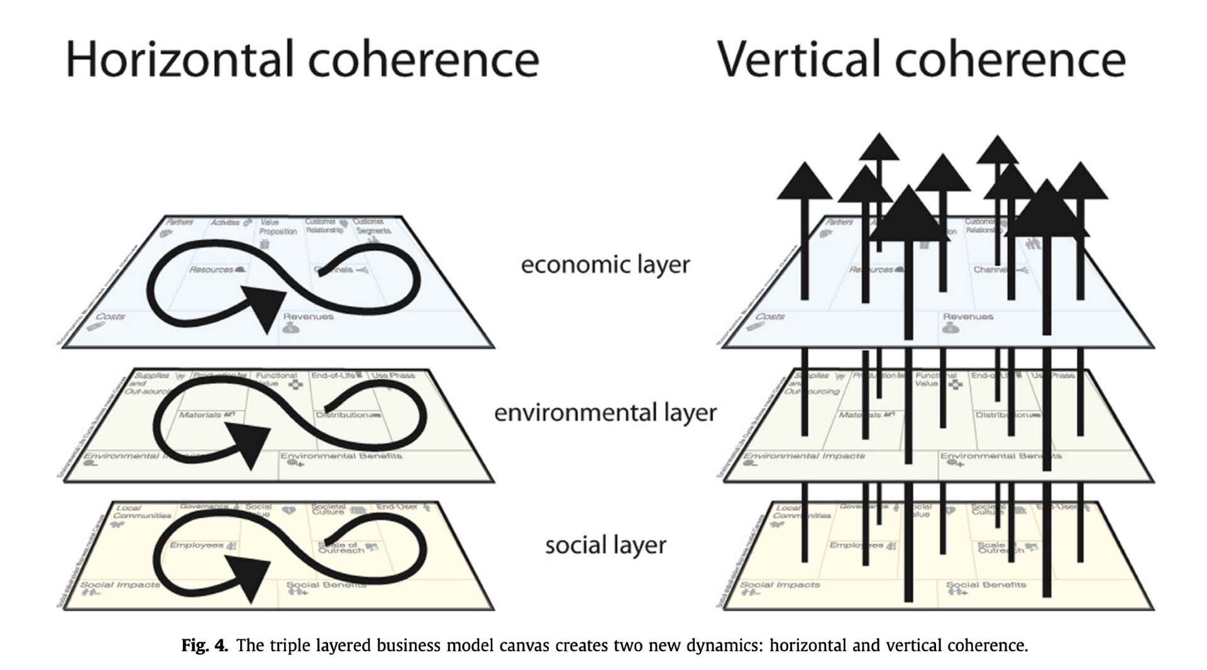

Slide 5
More on the subject:
www.Flixabout.com

